Slide 1
MATLAB for Image Processing
CS638-1 TA: Tuo Wang
tuowang@cs.wisc.edu
Feb 12th, 2010

Slide 2
Outline
Introduction to MATLAB
  Basics & Examples
Image Processing with MATLAB
  Basics & Examples
Notes:
Firstly, I will talk about some basics of MATLAB, including the development environment, basic operations and syntax of MATLAB language, so that we can have a big picture of MATLAB.
Then, I will focus on the image processing issues with MATLAB.
At the end, I will give some more examples for demonstration.

Slide 3
What is MATLAB?
MATLAB = Matrix Laboratory
“MATLAB is a high-level language and interactive environment that enables you to perform computationally intensive tasks faster than with traditional programming languages such as C, C++ and Fortran.” (www.mathworks.com)
MATLAB is an interactive, interpreted language that is designed for fast numerical matrix calculations
Notes:
MATLAB stands for..

Slide 4
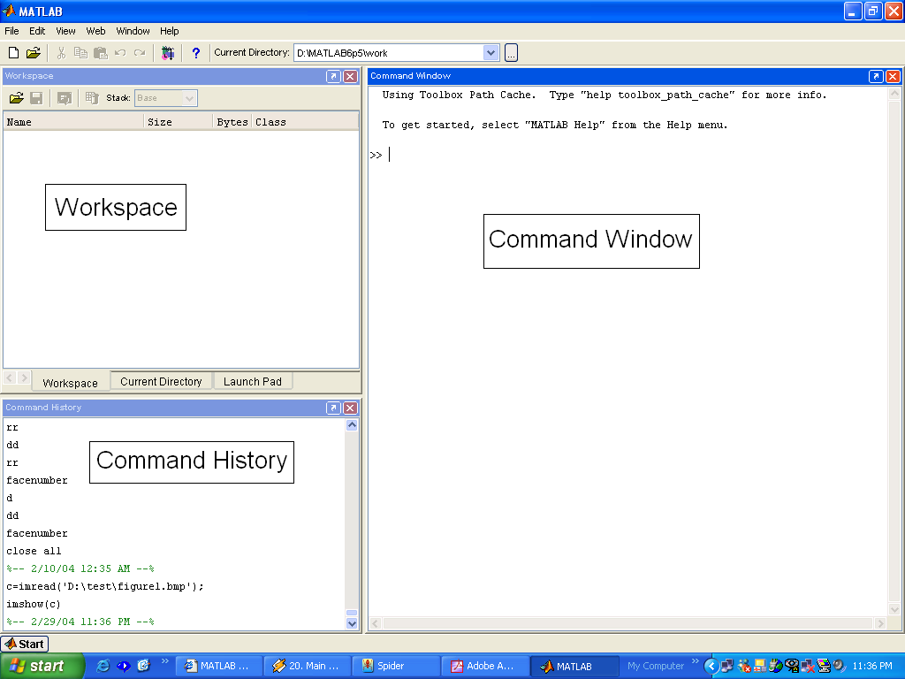
The MATLAB Environment
MATLAB window components:
  Workspace
    > Displays all the defined variables
  Command Window
    > To execute commands in the MATLAB environment
  Command History
    > Displays record of the commands used
  File Editor Window
  > Define your functions

Slide 5
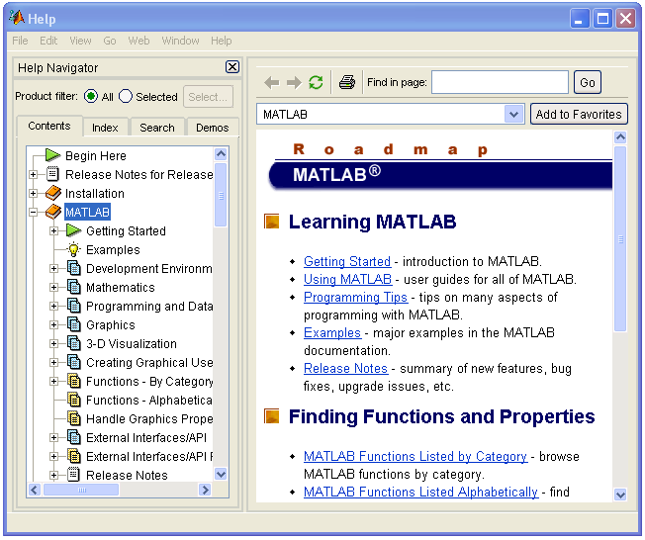
MATLAB Help
MATLAB Help is an extremely powerful assistance to learning MATLAB
Help not only contains the theoretical background, but also shows demos for implementation
MATLAB Help can be opened by using the HELP pull-down menu

Slide 6
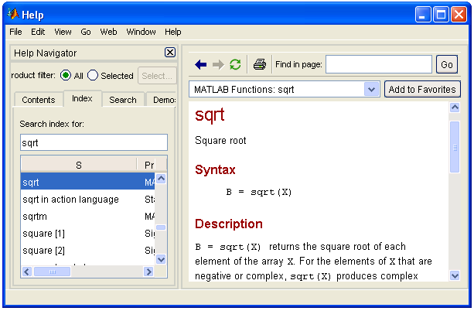
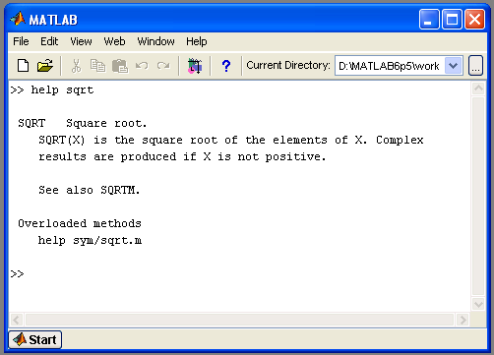
MATLAB Help (cont.)
Any command description can be found by typing the command in the search field
As shown above, the command to take square root (sqrt) is searched
We can also utilize MATLAB Help from the command window as shown

Slide 7
More about the Workspace
who, whos – current variables in the workspace
save – save workspace variables to *.mat file
load – load variables from *.mat file
clear – clear workspace variables
- CODE

Slide 8
Matrices in MATLAB
Matrix is the main MATLAB data type
How to build a matrix?
  A=[1 2 3; 4 5 6; 7 8 9];
  Creates matrix A of size 3 x 3
Special matrices:
  zeros(n,m), ones(n,m), eye(n,m), rand(), randn()
Notes:
After looking through the developing environment, let’s have a look at MATLAB language itself

Slide 9
Basic Operations on Matrices
All operators in MATLAB are defined on matrices: +, -, *, /, ^, sqrt, sin, cos, etc.
Element-wise operators defined with a preceding dot: .*, ./, .^
size(A) – size vector
sum(A) – columns sums vector
sum(sum(A)) – sum of all the elements
- CODE

Slide 10
Variable Name in Matlab
Variable naming rules
- must be unique in the first 63 characters
- must begin with a letter
- may not contain blank spaces or other types of punctuation
- may contain any combination of letters, digits, and underscores
- are case-sensitive
- should not use Matlab keyword
Pre-defined variable names
  pi

Slide 11
Logical Operators
==, <, >, (not equal) ~=, (not) ~
find(‘condition’) – Returns indexes of A’s elements that satisfy the condition

Slide 12
Logical Operators (cont.)
Example:
>>A=[7 3 5; 6 2 1], Idx=find(A<4)
  A=
    7 3 5
    6 2 1
  Idx=
    3
    4
    6
Notes:
Return linear indices

Slide 13
Flow Control
MATLAB has five flow control constructs:
  if statement
  switch statement
  for loop
  while loop
  break statement

Slide 14
if
IF statement condition
  The general form of the IF statement is
    IF expression
      statements
    ELSEIF expression
      statements
    ELSE
      statements
    END
    CODE

Slide 15
switch
SWITCH – Switch among several cases based on expression
The general form of SWITCH statement is:
  SWITCH switch_expr
    CASE case_expr,
      statement, …, statement
    CASE {case_expr1, case_expr2, case_expr3, …}
      statement, …, statement
      …
    OTHERWISE
      statement, …, statement
  END

Slide 16
switch (cont.)
Note:
  Only the statements between the matching CASE and the next CASE, OTHERWISE, or END are executed
  Unlike C, the SWITCH statement does not fall through (so BREAKs are unnecessary)
  CODE

Slide 17
for
FOR repeats statements a specific number of times
The general form of a FOR statement is:
  FOR variable=expr
    statements
  END
  CODE

Slide 18
while
WHILE repeats statements an indefinite number of times
The general form of a WHILE statement is:
  WHILE expression
    statements
  END
  CODE

Slide 19
Scripts and Functions
There are two kinds of M-files:
  Scripts, which do not accept input arguments or return output arguments. They operate on data in the workspace
  Functions, which can accept input arguments and return output arguments. Internal variables are local to the function

Slide 20
Functions in MATLAB (cont.)
Example:
  A file called STAT.M:
    function [mean, stdev]=stat(x)
    %STAT Interesting statistics.
    n=length(x);
    mean=sum(x)/n;
    stdev=sqrt(sum((x-mean).^2)/n);
  Defines a new function called STAT that calculates the mean and standard deviation of a vector. Function name and file name should be the SAME!
  CODE

Slide 21
Visualization and Graphics
plot(x,y),plot(x,sin(x)) – plot 1D function
figure, figure(k) – open a new figure
hold on, hold off – refreshing
axis([xmin xmax ymin ymax]) – change axes
title(‘figure titile’) – add title to figure
mesh(x_ax,y_ax,z_mat) – view surface
contour(z_mat) – view z as topo map
subplot(3,1,2) – locate several plots in figure
- CODE and Debug CODE

Slide 22
Saving your Work
save mysession
% creates mysession.mat with all variables
save mysession a b
  % save only variables a and b
clear all
  % clear all variables
clear a b
  % clear variables a and b
load mysession
  % load session

Slide 23
Outline
Introduction to MATLAB
  Basics & Examples
Image Processing with MATLAB
  Basics & Examples
Notes:
Firstly, I will talk about some basics of MATLAB, including the development environment, basic operations and syntax of MATLAB language, so that we can have a big picture of MATLAB.
Then, I will focus on the image processing issues with MATLAB.
At the end, I will give some more examples for demonstration.

Slide 24
What is the Image Processing Toolbox?
The Image Processing Toolbox is a collection of functions that extend the capabilities of the MATLAB’s numeric computing environment. The toolbox supports a wide range of image processing operations, including:
  Geometric operations
  Neighborhood and block operations
  Linear filtering and filter design
  Transforms
  Image analysis and enhancement
  Binary image operations
  Region of interest operations

Slide 25
Images in MATLAB
MATLAB can import/export several image formats:
  BMP (Microsoft Windows Bitmap)
  GIF (Graphics Interchange Files)
  HDF (Hierarchical Data Format)
  JPEG (Joint Photographic Experts Group)
  PCX (Paintbrush)
  PNG (Portable Network Graphics)
  TIFF (Tagged Image File Format)
  XWD (X Window Dump)
  raw-data and other types of image data
Data types in MATLAB
  Double (64-bit double-precision floating point)
  Single (32-bit single-precision floating point)
  Int32 (32-bit signed integer)
  Int16 (16-bit signed integer)
  Int8 (8-bit signed integer)
  Uint32 (32-bit unsigned integer)
  Uint16 (16-bit unsigned integer)
  Uint8 (8-bit unsigned integer)

Slide 26
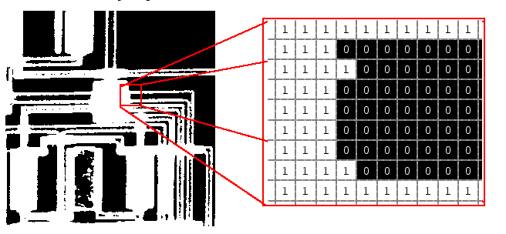
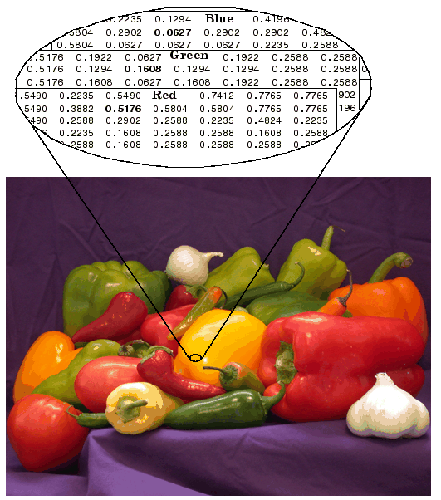
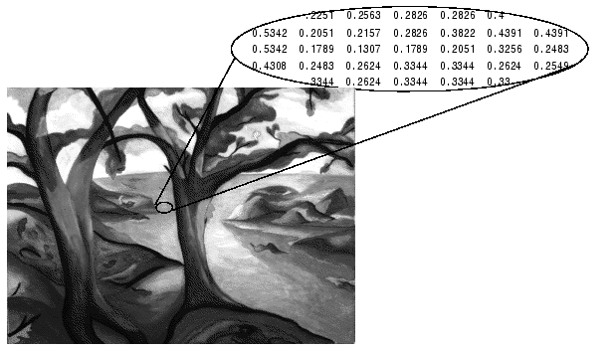
Images in MATLAB
• Binary images : {0,1}
• Intensity images : [0,1] or uint8, double etc.
• RGB images : m × n × 3
• Multidimensional images: m × n × p (p is the number of layers)

Slide 27
Image Import and Export
Read and write images in Matlab
  img = imread('apple.jpg');
  dim = size(img);
  figure;
  imshow(img);
  imwrite(img, 'output.bmp', 'bmp');
Alternatives to imshow
imagesc(I)
imtool(I)
image(I)
Notes:
The imagesc function scales image data to the full range of the current colormap and displays the image.
imtool opens a new Image Tool in an empty state. imtool(I) displays the grayscale image I.
image(C) displays matrix C as an image.

Slide 28

Images and Matrices
[0, 0]
How to build a matrix
(or image)?
Intensity Image:
  row = 256;
  col = 256;
  img = zeros(row, col);
  img(100:105, :) = 0.5;
  img(:, 100:105) = 1;
  figure;
  imshow(img);
o
Row 1 to 256
o
Column 1 to 256
[256, 256]

Slide 29

Images and Matrices
Binary Image:
row = 256;
col = 256;
img = rand(row, col);
img = round(img);
figure;
imshow(img);

Slide 30
Image Display
image - create and display image object
imagesc - scale and display as image
imshow - display image
colorbar - display colorbar
getimage - get image data from axes
truesize - adjust display size of image
zoom - zoom in and zoom out of 2D plot

Slide 31
Image Conversion
gray2ind - intensity image to index image
im2bw - image to binary
im2double - image to double precision
im2uint8 - image to 8-bit unsigned integers
im2uint16 - image to 16-bit unsigned integers
ind2gray - indexed image to intensity image
mat2gray - matrix to intensity image
rgb2gray - RGB image to grayscale
rgb2ind - RGB image to indexed image

Slide 32
Image Operations
RGB image to gray image
Image resize
Image crop
Image rotate
Image histogram
Image histogram equalization
Image DCT/IDCT
Convolution
- CODE

Slide 33
Outline
Introduction to MATLAB
  Basics & Examples
Image Processing with MATLAB
  Basics & Examples
Notes:
Firstly, I will talk about some basics of MATLAB, including the development environment, basic operations and syntax of MATLAB language, so that we can have a big picture of MATLAB.
Then, I will focus on the image processing issues with MATLAB.
At the end, I will give some more examples for demonstration.

Slide 34
Examples working with Images (1/3)
Create AVI movie with a series images
Video

Slide 35
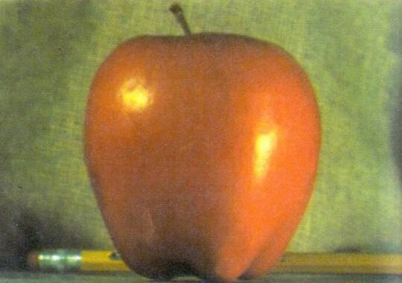
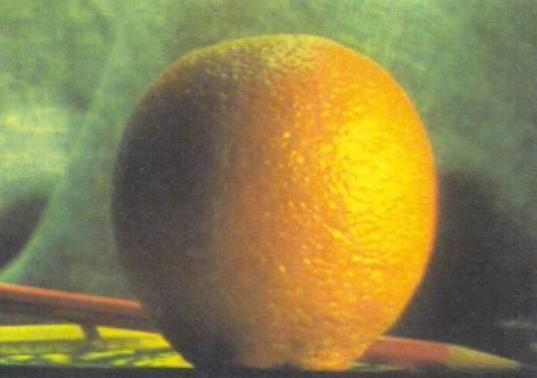
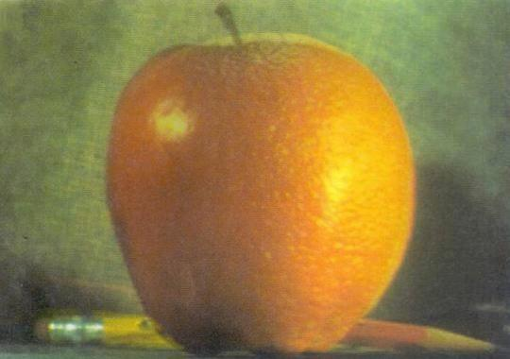
Examples working with Images (2/3)
Blending two images

Slide 36
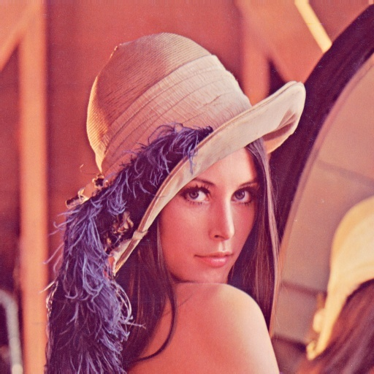
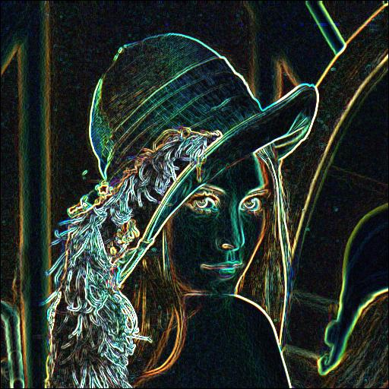
Examples working with Images (3/3)
Sobel descriptor to detect object edge

Slide 37
Performance Issues
The idea: MATLAB is
  very fast on vector and matrix operations
  Correspondingly slow with loops
Try to avoid loops
Try to vectorize your code
http://www.mathworks.com/support/tech-notes/1100/1109.html

Slide 38
Vectorize Loops
Example
  Given image matrices, A and B, of the same size (540*380), blend these two images
  apple = imread(‘apple.jpg');
  orange = imread(‘orange.jpg’);
Poor Style
% measure performance using stopwatch timer
tic
for i = 1 : size(apple, 1)
for j = 1 : size(apple, 2)
for k = 1 : size(apple, 3)
output(i, j, k) = (apple(i, j, k) + orange(i, j, k))/2;
end
end
end
toc
Elapsed time is 0.138116 seconds

Slide 39
Vectorize Loops (cont.)
Example
  Given image matrices, A and B, of the same size (600*400), blend these two images
  apple = imread(‘apple.jpg');
  orange = imread(‘orange.jpg’);
Better Style
  tic % measure performance using stopwatch timer
  Output = (apple + orange)/2;
  toc
  Elapsed time is 0.099802 seconds
Computation is faster!

Slide 40
THE END
Thanks for your attention! ☺
Questions?

